Slide 1
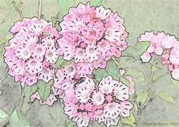
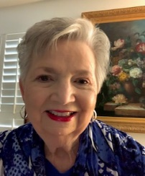
Laurel Letters
Summer 2024
District Director
Cheryl Briscoe
Co-Director
Merrell Holden
Recording
Secretary
Kathy Shiner
Corresponding Secretary
Maye Suddath
Treasurer
Dee Anne Wyse
Chaplain
Rene Lanier
Parliamentarian
Edna McClellan
Advisors
Caroline Alford, Edna McClellan, Marie Purser, John Barnett
Dear Laurels,
Many of you are preparing for summer break from garden club meetings after celebrating your 2023-2024 many accomplishments and awards. I was so honored to come into your homes and your meeting places to share time with you this past few months. Thank you for inviting me!
In March, I met with Sixes Community Garden Club in Canton where we discussed our multiple levels of garden club organizations including National, Deep South, State of Georgia, and Laurel District. This club added new members this year (YAY!) so they wanted everyone to understand what each organization offers our members.
In April, I had the privilege of attending the Garden Club of Georgia Annual Convention in Peachtree City with many Laurel District representatives! We learned, socialized, listened, received many awards and enjoyed our time together. We cheered for Marci Wilcox who was our participant in a flower design contest and she did a beautiful job. Also in April, I attended the annual Cherokee GC Council Tea in the Ball Ground Botanical Gardens for a special presentation (see article) and lots of fun.
May brought the annual dk Gallery Bloom II event to benefit the Marietta Educational Garden Center, the Townview GC 75th Anniversary in Rome (see articles). Additionally, I attended the Greenhouse Gang Plant Sale at North Cobb High School in Kennesaw and the Friends of the State Botanical Garden Meeting in Athens.
Although we all may not have club meetings in the summer, I know I will see many of you at the planning meetings that take place during those months: Cannonball Classic Golf Tournament (August 26th), Laurel District Annual Meeting (Oct. 9th) and Historic Landscape Preservation Fundraiser (November 2nd). Please add these events to your calendars! For those of you who are planning your 2024-2025 meetings, look for the list of the best 2023-2024 programs submitted in Presidents’ reports coming to your club Presidents soon.
Stay cool!
Cheryl Briscoe, Laurel District Director 2023-2025

Slide 2
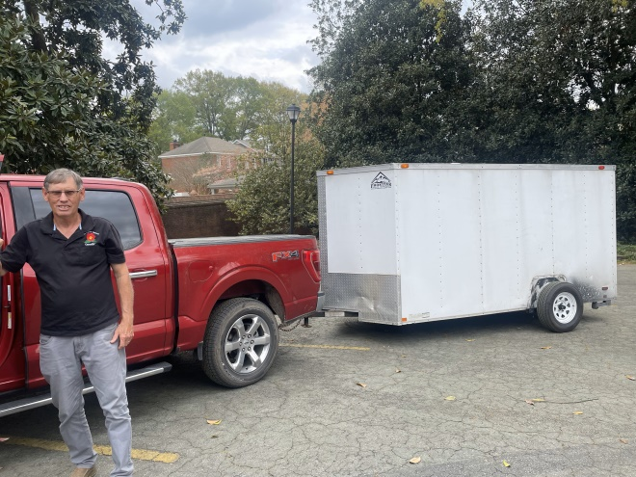
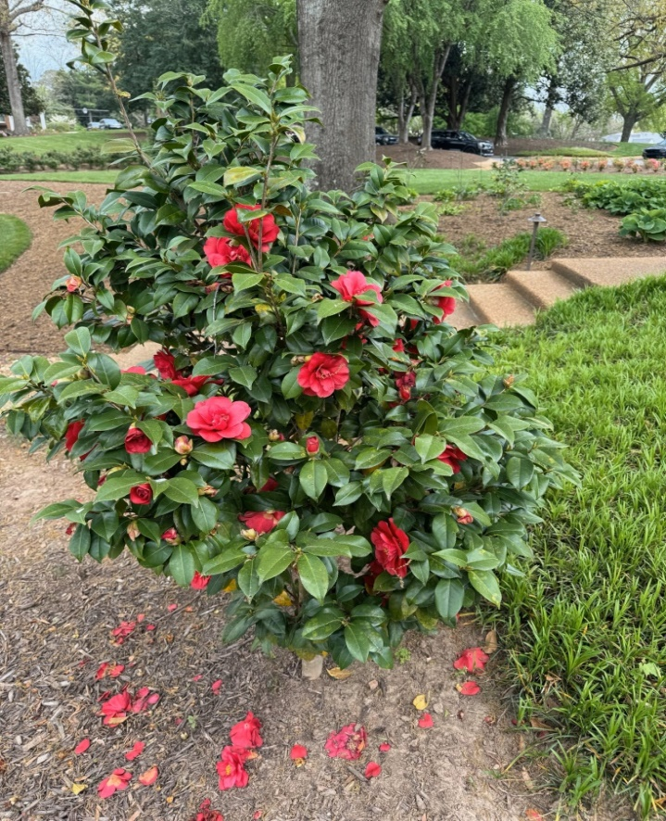
Marietta Educational Garden Center
The First Ladies Have Arrived in Marietta
Yes, they have… in the form of camellias, that is.
The Marietta Educational Garden Center at 505 Kennesaw Avenue has recently received an entire set of ten camellias, named after the last ten First Ladies who have lived in the Governor’s Mansion. The camellias are propagated and sold exclusively as a set from Loch Laurel Nursery in Valdosta, Georgia (www.lochlaurelnursery.com) The nursery is owned and operated by plant scientist Mark Crawford.
The idea began when the William D. Smith family established the Sydney Cobb Smith Camellia Garden in memory of their mother. Mrs. Smith was a true southern lady, and the committee felt a camellia garden would be a fitting way to honor her memory. When the Trustees heard about the First Lady Collection, they immediately began to contact the nursery.
“We are thrilled with the opportunity honor Georgia’s First Ladies here at the Garden Center and look forward to welcoming visitors to see our camellia garden,” says Kathy Young, Marietta Educational Garden Center, Inc. Board of Trustees Chair
Plans were made for delivery, and as of last week, Marty Kemp, Sandra Deal, Mary Perdue, Marie Barnes, Shirley Miller, Elizabeth Harris, Mary Beth Busbee, Rosalyn Carter, Virginia Maddox, and Betty Foy Sanders were planted in the Sydney Smith Garden.
Mark Crawford of Loch Laurel Nursery arrives at the Garden Center to deliver the 10 Georgia First Lady Camellias.

Slide 3
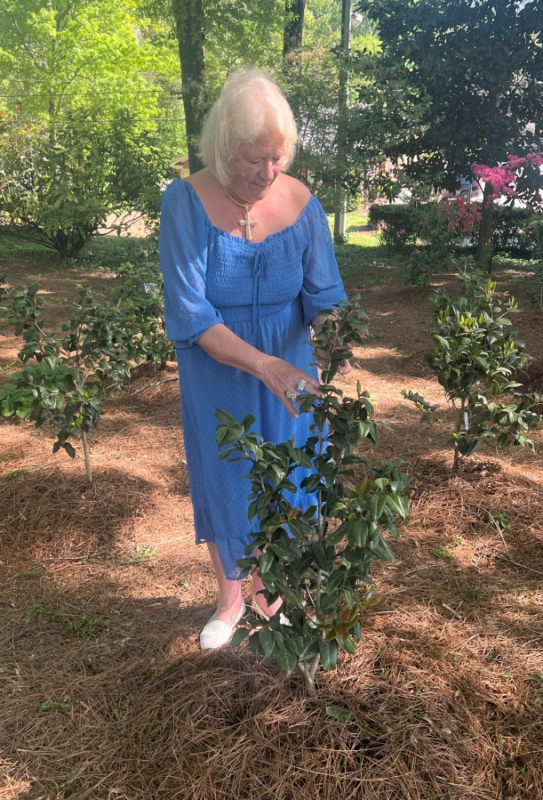
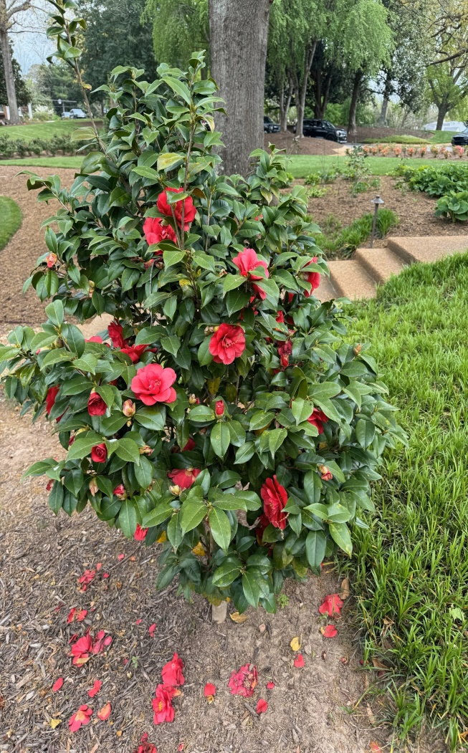
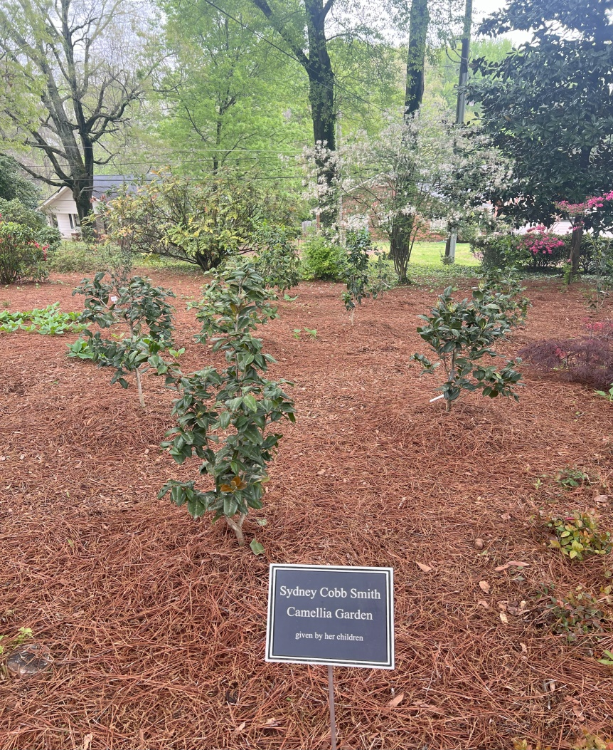
The idea was suggested by First Lady Sandra Deal midway through her husband Governor Nathan Deal’s two terms of office. A camellia had been named for Betty Foy Sanders some years back. The Tifton Garden Club initiated a movement to name one for Mrs. Deal. Upon receiving her honor, Mrs. Deal felt that each First Lady who had lived in the Mansion should have one named for her. She made contact with Mark Crawford, nursery owner of Loch Laurel Nursey in Valdosta, Georgia. He began identifying new seedlings from the japonica species that would be appropriate to create a new variety for each First Lady who had lived in the Governor’s Mansion on West Paces Ferry Road.
A set of the First Ladies can be seen at the Governor’s Mansion, and at the First Baptist Church in Gainesville, Georgia.
Marie Barnes attends to her newly planted camellia
As for now, there are only full two sets of First Lady Camellias in Cobb – the ones at the Marietta Educational Garden Center, and at the home of Mrs. Robert Bowden.
The Garden Center grounds are always open for strolling and viewing of their special gardens, many sponsored by various garden clubs in the county.

Slide 4
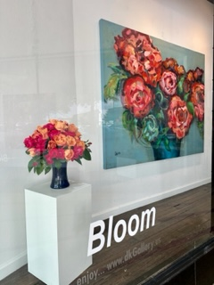
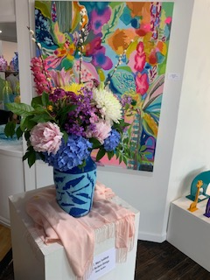
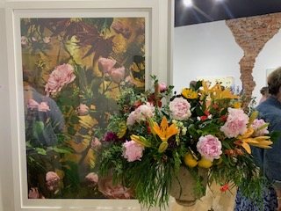
MEGC 2
Garden Clubs Bloom at MEGC Fundraiser
Bloom II, a fundraiser for the Marietta Educational Garden Center, was held the first Friday in May. Participants chose paintings from the dk Gallery’s website and created floral arrangements to complement them. This was a judged show with 18 entries submitted by garden club members whose clubs make up the Marietta Council of Garden Clubs.
Maye Suddath, The Flower Garden Club of Marietta President, won first place and Kathleen Rambo, member of English Laurel Garden Club, won second place. All entries were amazing!
Donna Krueger, owner, is a passionate and innovative contemporary fine art gallerist. Last year was so successful, she graciously hosted this event again giving proceeds from a raffle to the garden center. Thank you, Donna! Submitted by Cheryl Briscoe
1st Place Winner:
Maye Suddath,
The Flower Garden Club of Marietta
2nd Place Winner: Kathleen Rambo, English Laurel Garden Club

Slide 5
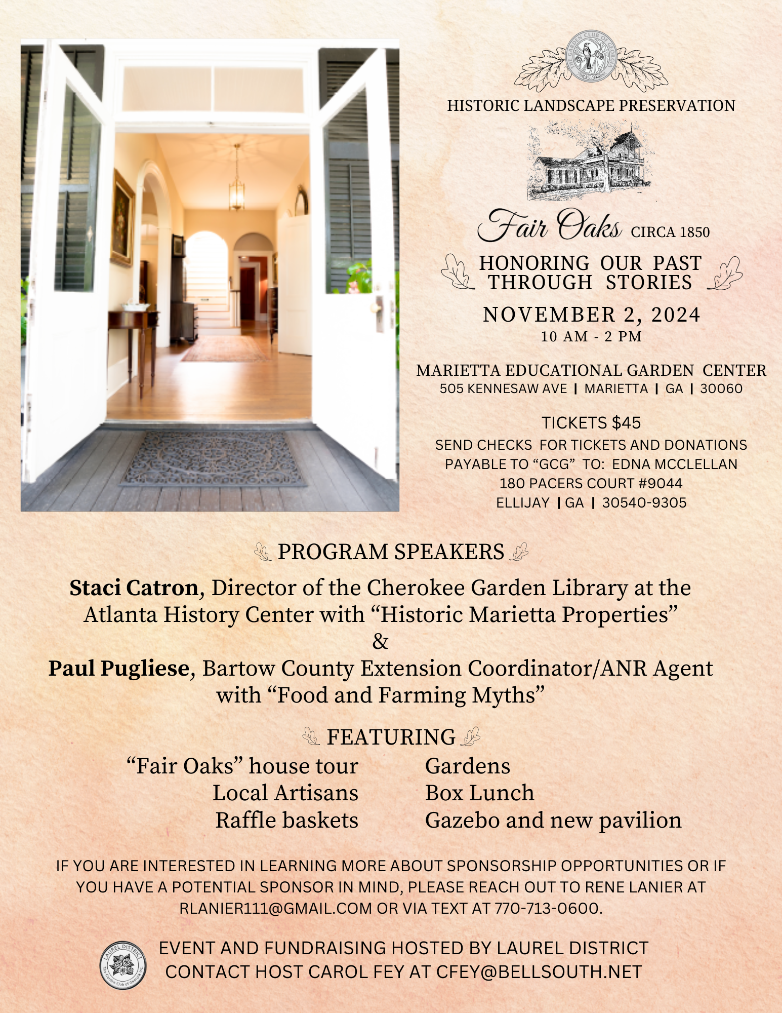

Slide 6
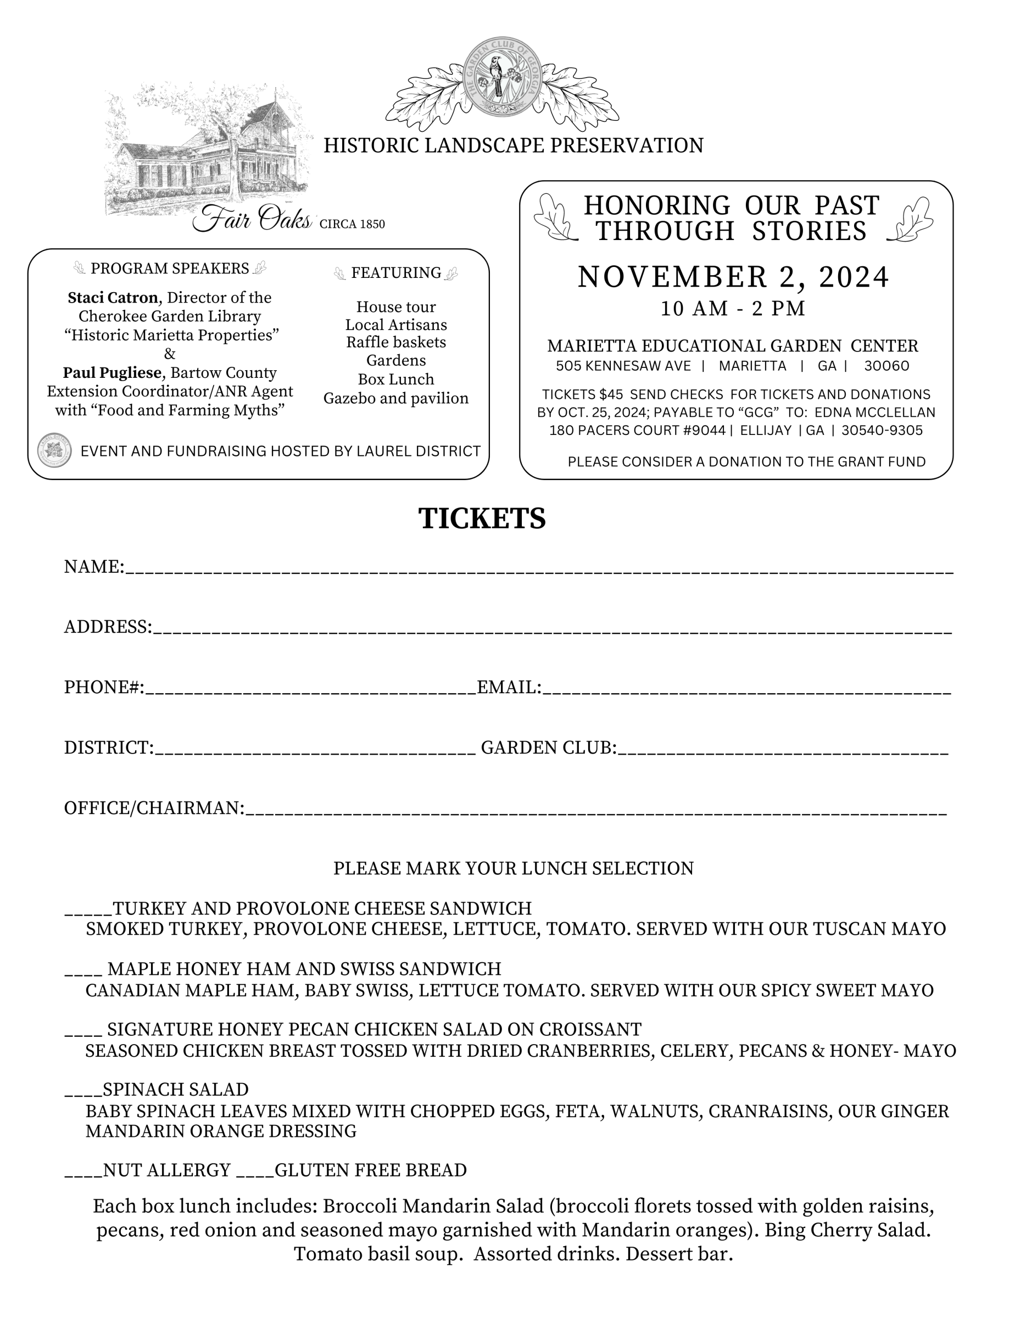

Slide 8
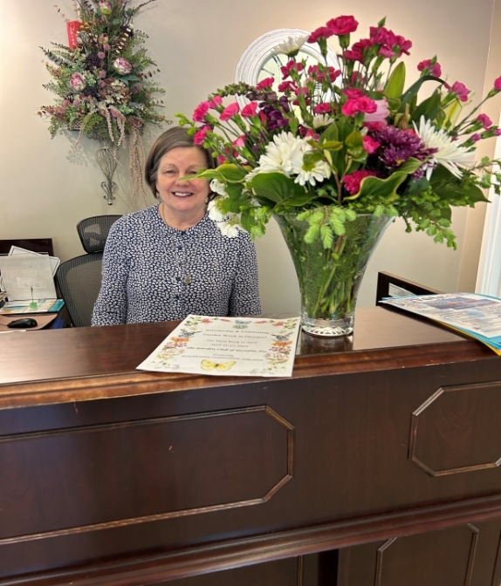
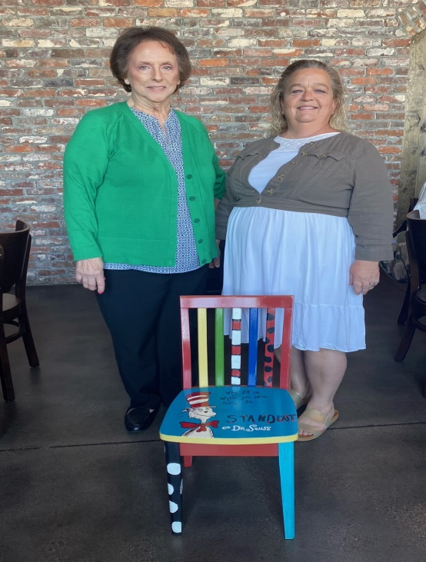
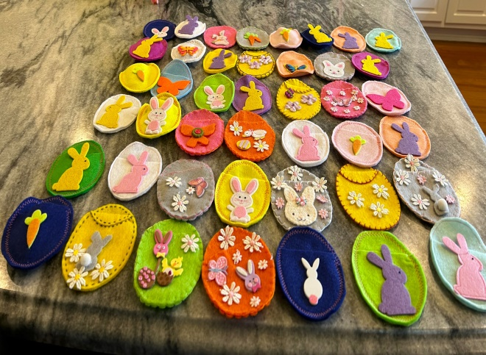
Amicalola Garden Club
Myriad Projects to Celebrate: Amicalola Garden Club Sees Success With Projects
On the agenda for our January meeting of the Amicalola Garden Club was the election of officers for the new year. Our officers are as follows: President Linda Allred, Vice President Peggy Andrews (new), Secretary Susan Armstrong/Glenda Thompson and Treasurer, Anita Poole. Plans were discussed and our programs decided upon for this year. Our horticulture tip was presented on the differences between Christmas, Thanksgiving and Easter cactus. Cuttings were provided for each member.
February, March and April have been crazy trying to get a lot accomplished before our break in May. Our speaker in February was Master Gardener Heather Giambra and Charlie Clenaey, President of Master Gardeners for Pickens County. They presented a very informative program on pruning, thinning, mulching and composting which is a spring list of priorities for our gardens. The horticulture tips this month was on the history of the Bonsai tree with proper care for ultimate success in growing. Solar lights for the Tate Cemetery were donated and installed by club member JoAnne Hirtle. Our three nursing homes in Pickens County were to be contacted to find out what they needed for their gardens this year. Our members were asked to bring donations in March.
Our March meeting was our Celebration of 89 years as a garden club which was held at the Old Mule House Restaurant in Jasper. This meeting was about giving donations to our elementary schools for their gardening programs. Our speakers were introduced by Vice President Peggy Andrews. Each school sent a representative to talk about their program and receive their donation. One elementary class was presented with a chair painted with Dr. Suess for their reading corner. This chair was painted by a club member for her daughter’s class.
Our donations from club members were collected and delivered to the three nursing homes for their gardens. We collected potting soil, spades, seeds, gloves and tomato plants. I visited one of their gardens in early May and they did an excellent job. We chose one nursing home to give decorated felt eggs made by club members for Easter for our Fig Leaf project.
FRESH FLOWERS:AGC Celebrates Georgia Garden Club Week

Slide 9
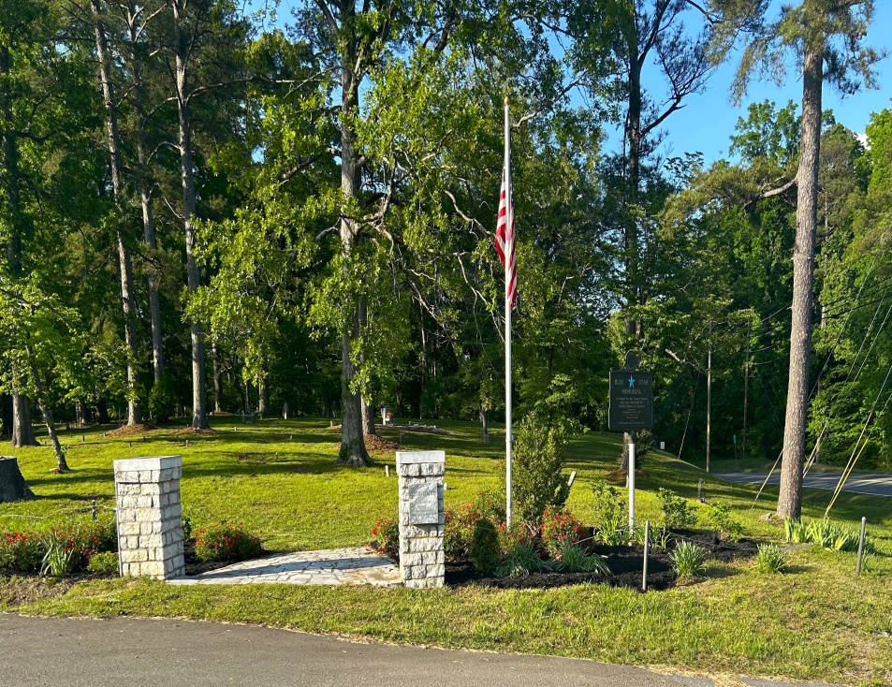
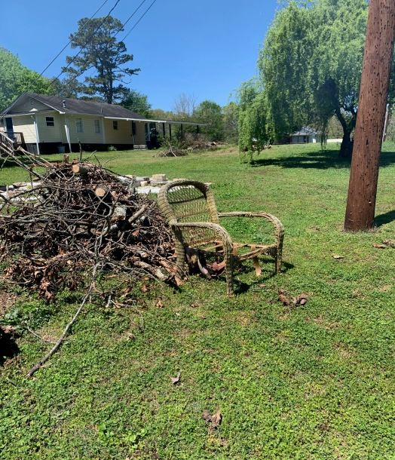
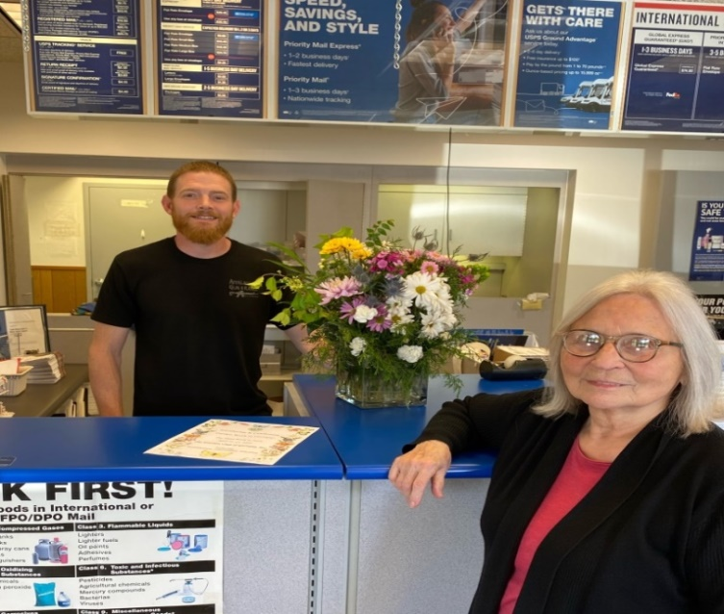
Amicalola 2
April and May were clean up time. Freedom Park was overgrown with weeds and trees that needed pruning and new mulch needed to be added. This was all accomplished by hiring a landscaping service. New blue bird houses were added. They were made by a club member Lynn Johnson's husband and donated to and placed in Freedom Park. This is the location of The Blue Star By-Way marker. In the Historical Tate Cemetery, where our Blue Star Marker is placed, loads of brush, tree limbs, and trash was collected and burned. New mulch and plants were added to the cemetery entrance. A great job was done by club members Peggy Andrews and Sally Eubanks with landscape help from Leo Hampton.
Garden Club week in Georgia, April 21 through 27, was celebrated with proclamations posted in our Tate Post Office, On line, and county offices. We presented flower arrangements made with cut flowers to the Pickens County Administration Building lobby and to the Tate Post Office. Hydrangeas were planted in the Historical Tate Cemetery.
Our May meeting will include a picnic lunch on the back porch of club member, Penny Davis, with flower arrangements made by our club members to be judged. June will include a plant sale and tour of a neighboring garden. Looking forward to our summer break.
By
President Linda Allred Amicalola Garden Club
Above: Freedom Park, location
of The Blue Star By-Way marker
- day for garden clubbers
Below:
Celebrating Garden Week in GA: Fresh Flowers for post office workers
Clean- up day for garden clubbers

Slide 10
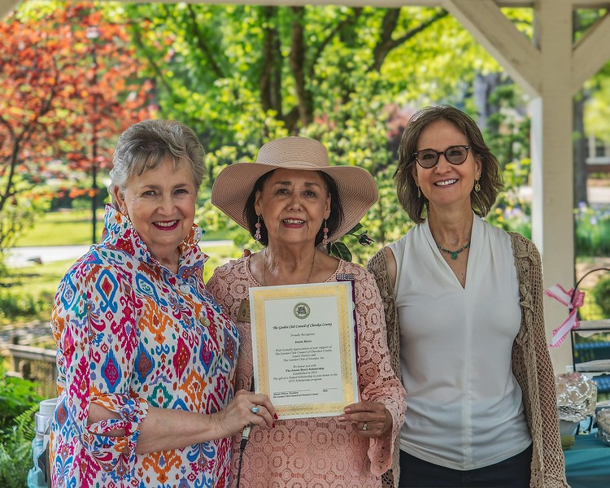
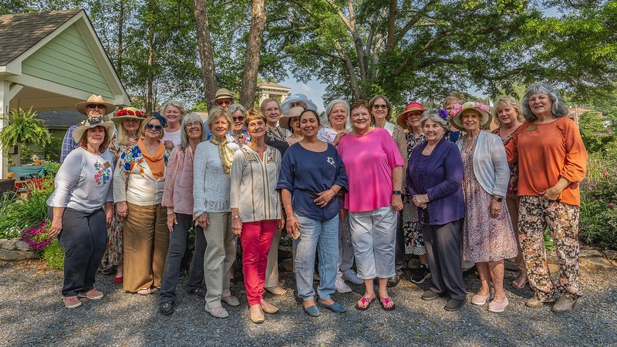
Cherokee Garden Clubs Council
Jennie Byers, Ball Ground Garden Club Member, was surprised to receive a $1,000 “named scholarship” in her honor at the annual Cherokee Council Tea in May. Jennie joined the Ball Ground Garden Club (Anetsa-Ga-Da) in 1969 and has served the club and the council in many ways over all those years.
In addition to serving as club President twice, she demonstrated exemplary participation and influential guidance in every facet of the club’s organization.
In 2012, Jennie led a team of 18 volunteers in the very successful Historic Garden Fundraiser for Gibbs Gardens for its grand opening. Her work with the City of Ball Ground included a Veterans Memorial dedication and, currently, she serves as liaison between the City of Ball Ground and the garden clubs. Most notably, she helped establish the Ball Ground Botanical Garden in 2015. She and the Ball Ground Garden Club hosted the Laurel District Annual Meeting at the Wheeler House in 2023.
Cheryl Briscoe, District Director;
Jennie Byers, Ball Ground Honoree;
Sharon Wilson, Cherokee Council of Garden Clubs President
The Cherokee Council Tea was the perfect setting for honoring Jennie since all the garden clubs in the council work and support the garden.
Article by Cheryl Briscoe
Cherokee Council of Garden Clubs

Slide 11
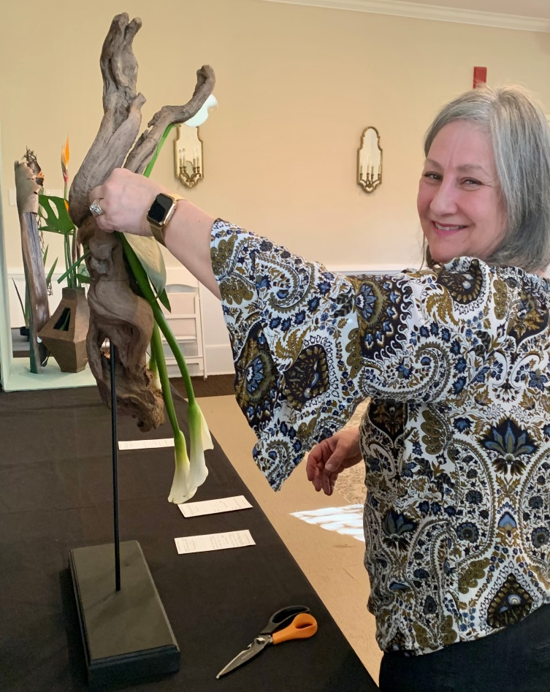
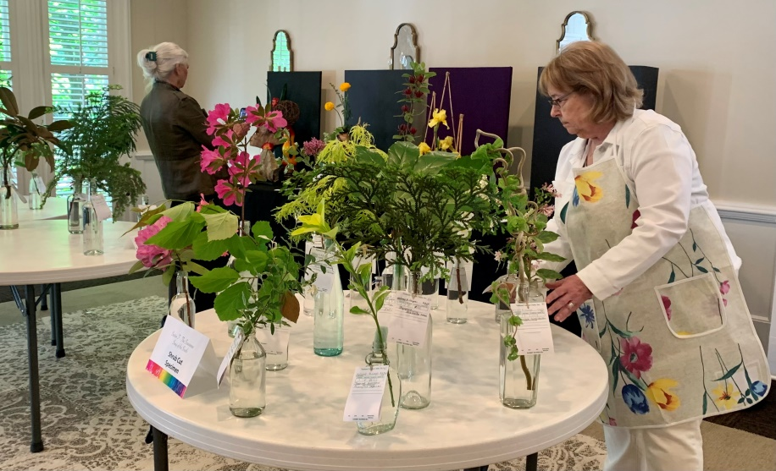
Creative Study Club
“Welcome to Georgia” Theme of Creative Study Club's April Flower Show Hosts Amazing Designs/Designers
Creative Study Club whose membership is flower show judges held a one-day small standard flower show at the Marietta Education Garden Center April 23. Edna McClellan, the chairman of the show, said, "This is the first time our club tried the
concept of an NGC small standard flower show, setting up and dismantling a show in
one day's time. We had three design classes with high-quality exhibits. All the exhibitors
were student judges who had completed Course IV of the NGC Flower Show School
held in Marietta.“
Michelle Culberson, (L) a student judge from Ellijay, won the Best in Show award for her entry in the design class, Balmy Coastal Plain.
Club members, NGC judges and student judges brought horticulture to fill the 30 classes of horticulture with 93 exhibits. An educational exhibit produced by another student judge showcased Georgia's state parks and preserving native species on public lands to carry out the theme of the flower show, "Welcome to Georgia".
Edna said, "Fair Oaks on Kennesaw Avenue in the historic district, the home of the
garden center, was the perfect location to hold the show. The spacious meeting room held exhibits while horticulture was prepared on the covered porch. The dining room was the site of the brunch for the three panels of judges who could relax in the library and front parlor as they arrived."
As Edna thanked the club members for the hard work of producing a show in one day she mentioned how everyone pitched in and helped wherever it was needed. These small acts of helping each other have been a hallmark of this judges study club founded almost 70 years ago.
Submitted by Anna Burns
Karin Guzy checks on final placement
For Horticulture

Slide 12
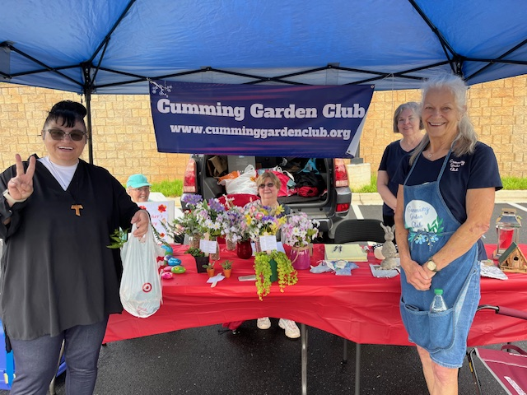
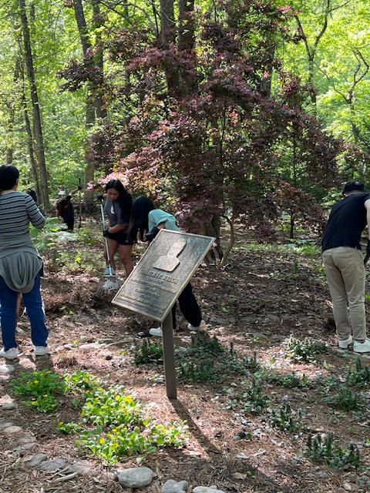
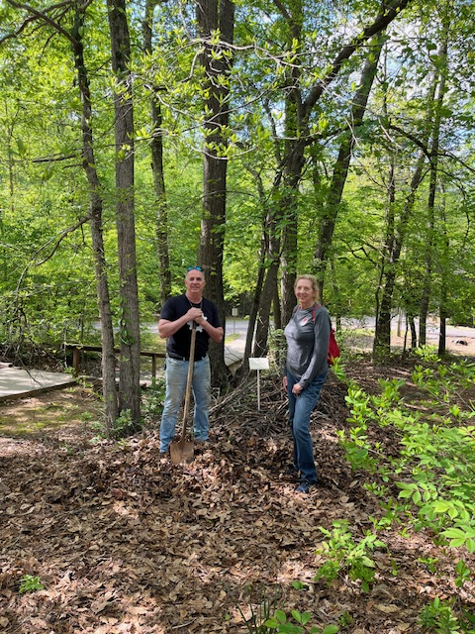
Cumming Garden Club
Cumming Garden Club Shines with Spring Projects
Cumming
Garden club fundraising at Cumming Farmers Market
International Club students assists with sprucing up Poole’s Mill park
Shown is a plaque in memory of Forsyth County Commissioner Charles Welch
Club president, Jill Denlea, gets an assist at Poole’s Mill park from her husband, Colin

Slide 13
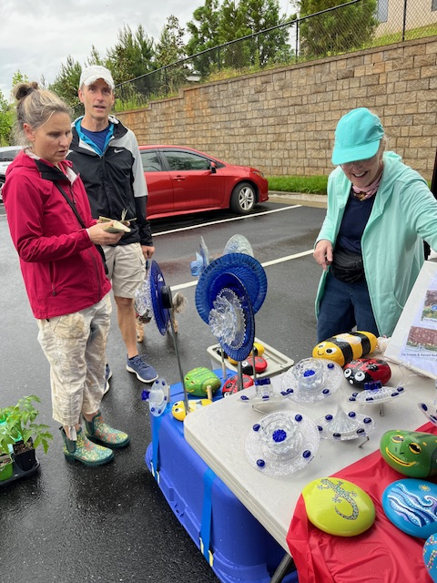
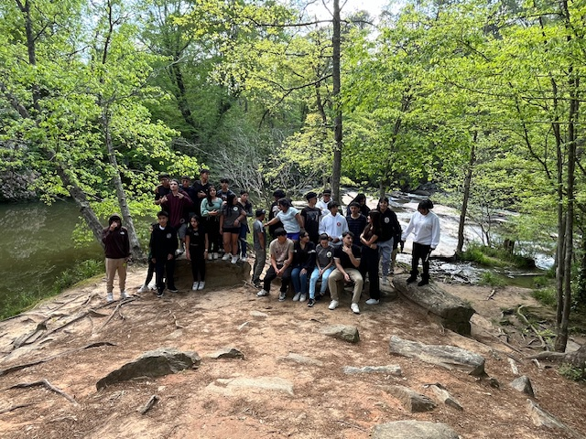
Cumming Garden Club 2
GC member Marion Rentz displays her Yard Art for sale at the Cumming Farmers’ Market
Forsyth Central High School International Club visits historic Poole’s Mill learning about the use of the mill by Cherokee Indians who lived in the area
Submitted by Linda Hardie

Slide 14
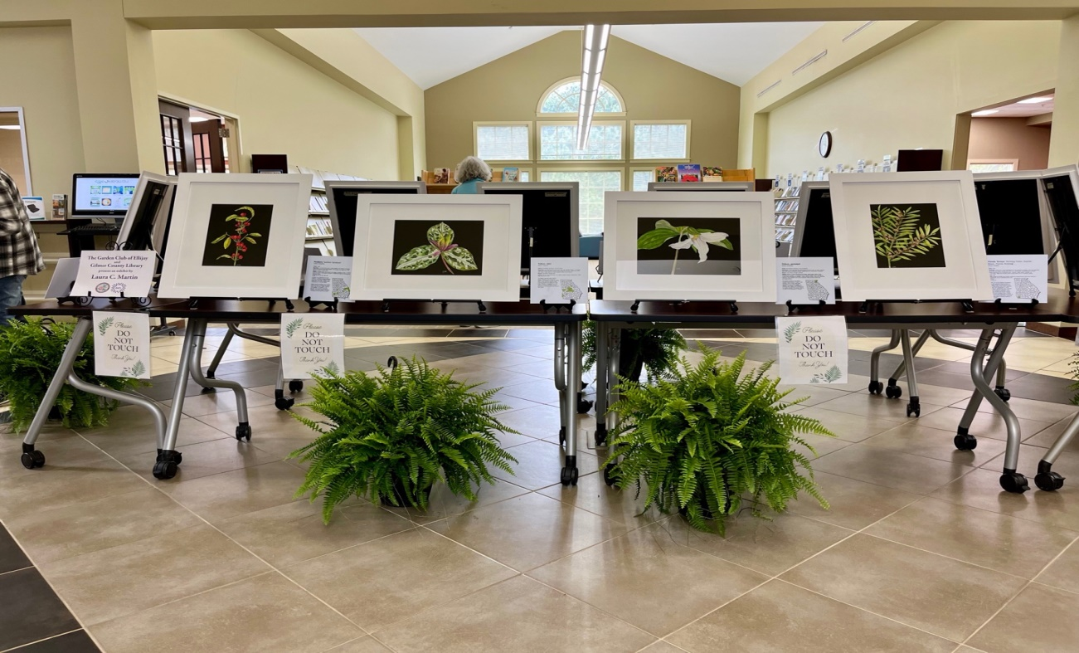
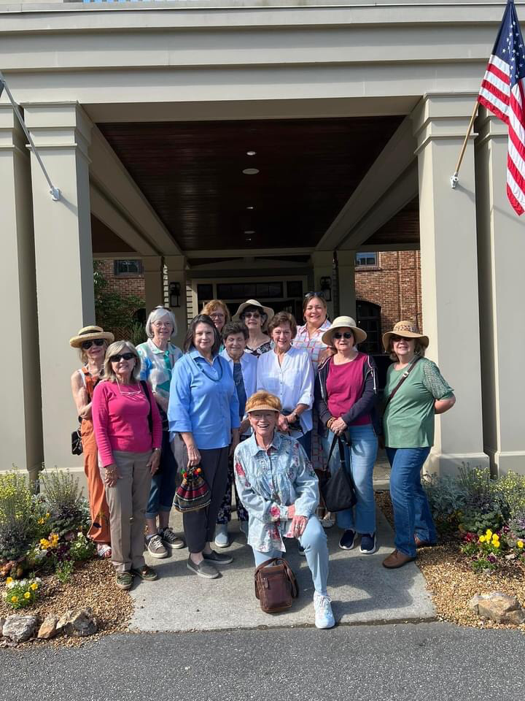
The Garden Club of Ellijay
Great Ways to Celebrate: Garden Club of Ellijay Hosts Exhibition, Gifts Gardening Books to Library, and Secures Proclamation of Garden Week in GA
The Garden Club of Ellijay and the Gilmer County Library hosted an exhibition titled “Imperiled Beauty; Georgia’s Endangered Plants” by Laura C. Martin as part of the Garden Club’s celebration of Garden Week in Georgia. Mrs. Martin has painted individual representations of Georgia’s endangered plants and produced supporting materials to identify these plants and where in Georgia they are located.

Slide 15
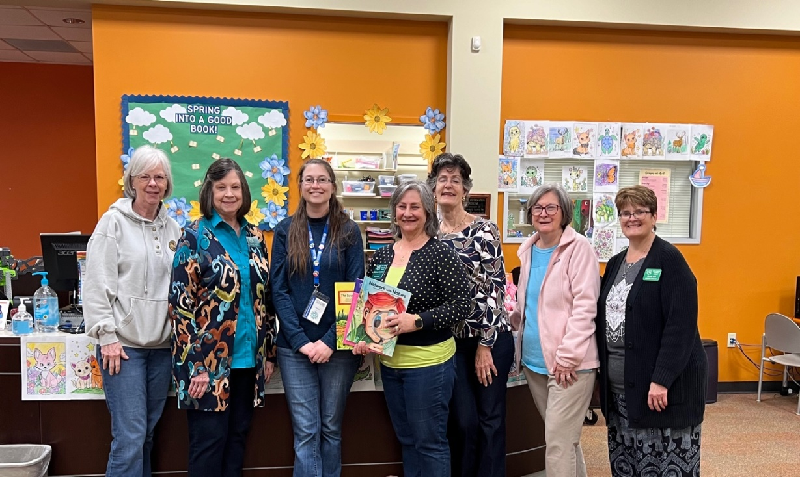
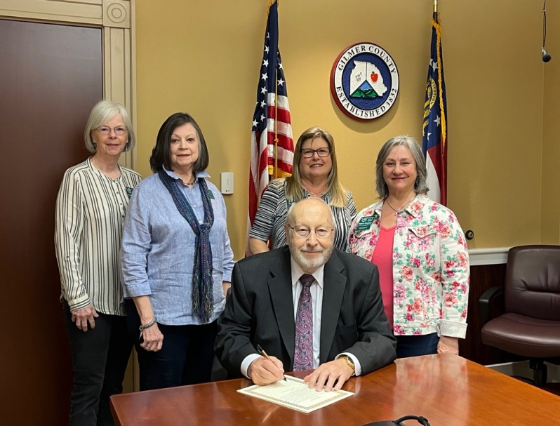
Garden Club of Ellijay 2
National Garden Clubs, Inc. publishes books for kids to begin a lifelong love of gardening, care for the environment. The club purchased three of these books and donated them to Gilmer County Library in honor of the future gardeners in their county and gave away another set during Garden Week.
Charlie Paris, Commissioner of Gilmer County, officially proclaimed Garden Week in Gilmer County as the club enjoyed their week of activities.
Submitted by Joanne Waddey, Vice-president

Slide 16
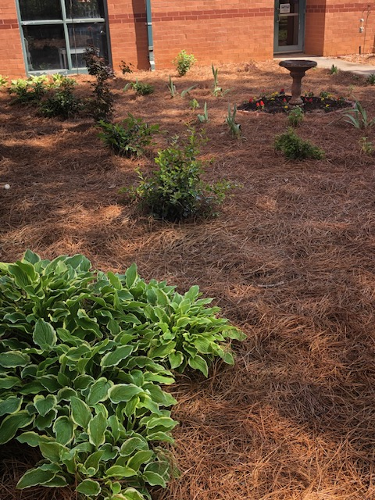
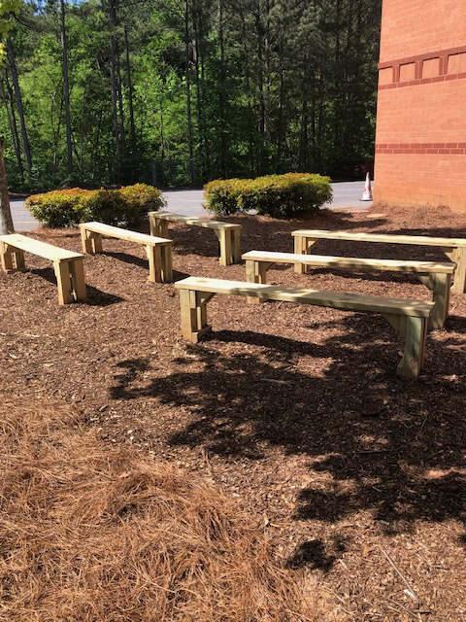
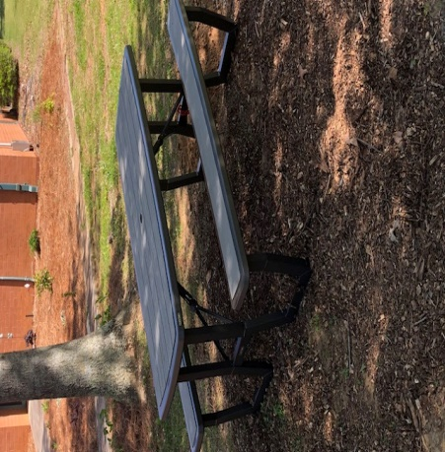
Flower Garden Club
Flower Garden Club Receives NGC Grant, Creates School Garden
The Flower Garden Club has been very busy this spring with several projects. In March, members visited the Lembeck Center in Marietta for the fourth year to help 140 preschoolers plant seeds, sing songs about plants, do an art activity and hear a story about seeds and plants.
Also members continued to collect used plastic pots to recycle at Lowe’s for our recycling project.
Our biggest project to date is creating a school garden at Hayes Elementary School. In November, project chairmen visited the site at the elementary school and in December, the site was cleared with financial assistance of the club, the Rotary Club of Marietta Metro, the PTSA, and Creative Landscaping.
The club received a $1,000 grant from the National Garden Club in December and in April, a wall was painted by members and members of the Rotary Club constructed 6 benches for the outdoor classroom. Large plants were purchased, and members contributed plants from their own yards . On April 27th the plants and paths were installed at the school by club members,
Rotarians and parents and children from the school. The club was able to install a picnic bench as well, and we look forward to adding more elements to the garden.
Submitted by Maye Suddath

Slide 17
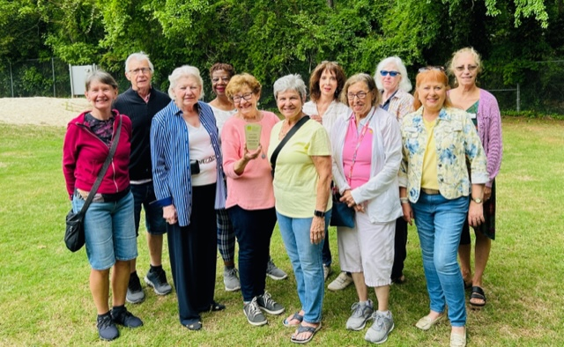
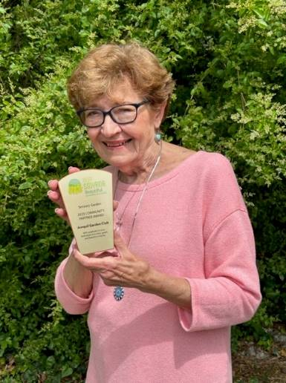
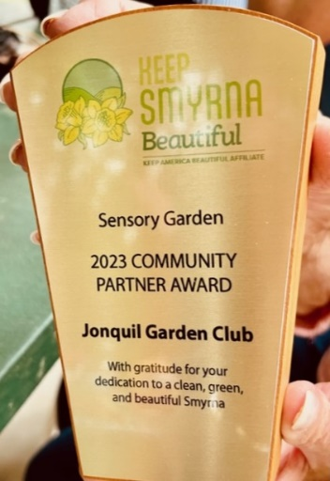
Jonquil Garden Club
Members who
attended the picnic to receive the award
The Jonquil Garden Club Receives 2023 KSB Community Partner Award
Keep Smyrna Beautiful is a non-profit organization in Smyrna whose mission is to bring together the resources of government, businesses and residents of the City of Smyrna to protect and improve the quality of life and the environment in the community.
In April, they presented a Community Partner Award to the Jonquil Garden Club. In a statement by the Director of KSB, the Jonquil Garden Club “has been instrumental in their partnership with Keep Smyrna Beautiful, from partnering with us in maintaining the beautiful Sensory Garden, to volunteering for the Annual Garden Tour, and more—your group has been a wonderful community partner over the years. For this reason, we have chosen your group as a 2023 Award Winner.”
At a picnic to present the awards, members of the Jonquil Garden Club, including Sensory Garden Chairperson Shirley Priest, and members of the Sensory Garden Team, attended and were honored to accept the award.
Shirley Priest, Sensory Garden Chairperson, receives
The KSB Community Partner Award

Slide 18
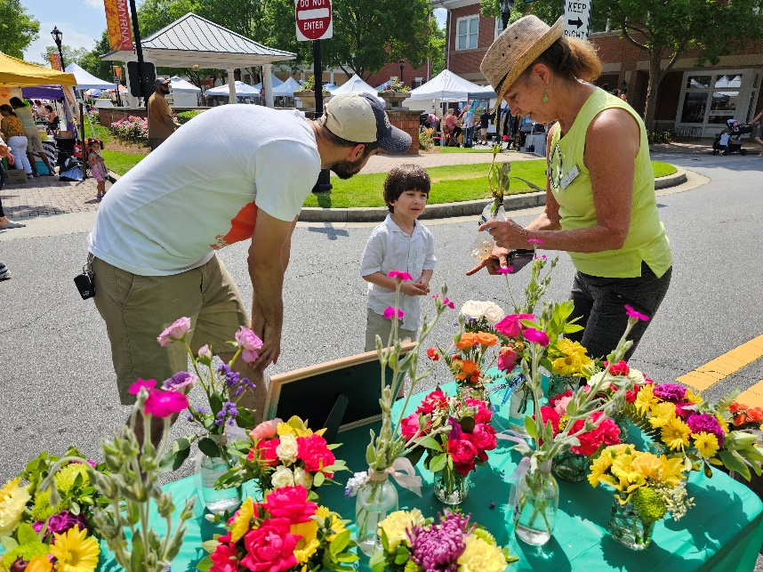
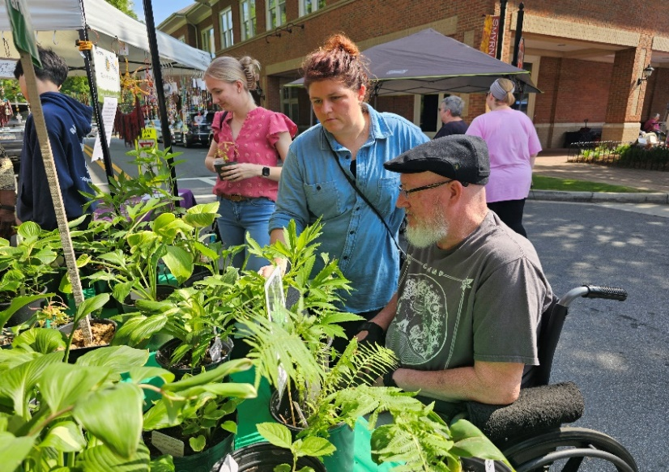
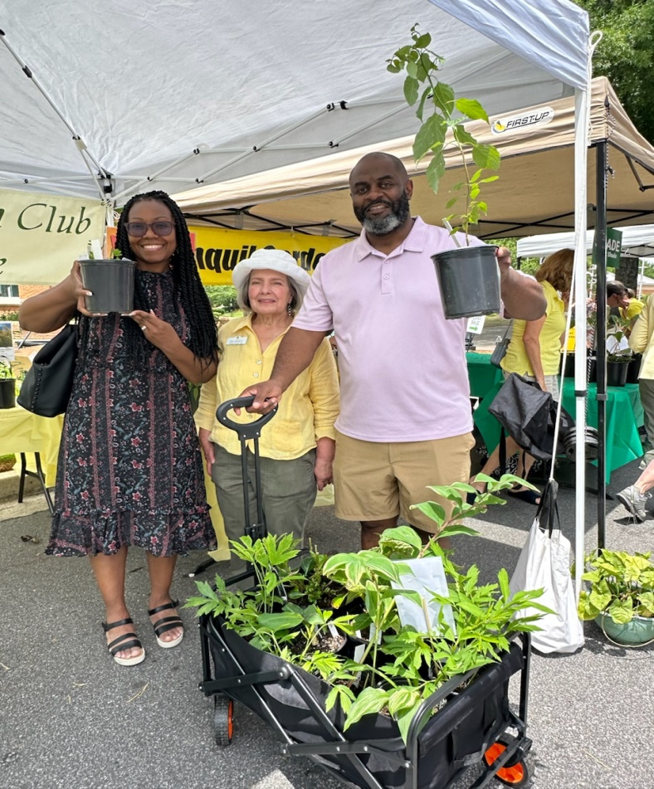
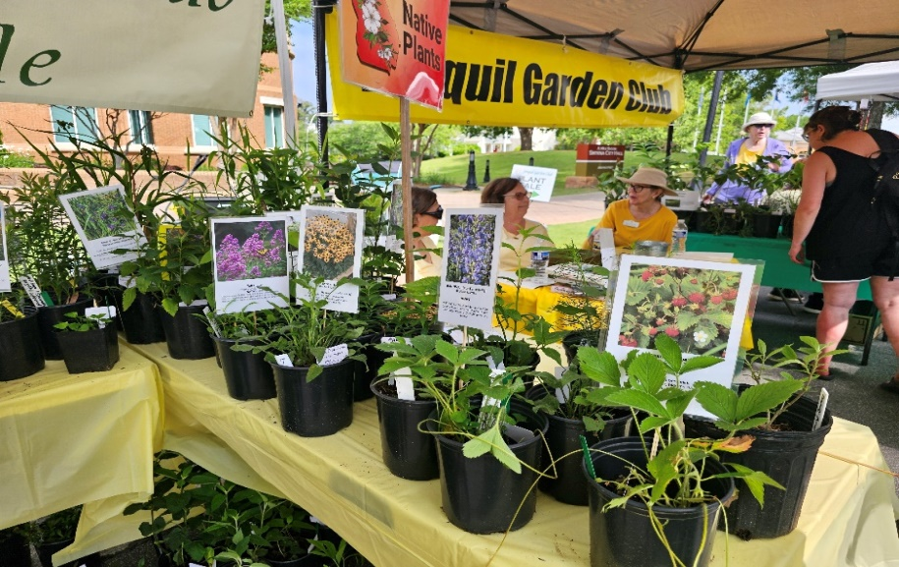
Jonquil Garden Club 2
Jonquils Exceed Goal With Annual Plant Sale
The Jonquil Garden Club held its Annual Plant Sale on Sunday, May 5, at the Smyrna Handmade Market. The sale is held to raise funds for a horticultural student scholarship, as well as various club projects and activities.
This year’s sale was a fantastic success! Seasoned gardeners and novices came to purchase plants that were provided from club members’ gardens. Tables of native plants, sun and shade varieties, annuals and perennials were all available at very reasonable prices.
An “Ask an Expert” table provided expert answers to customers’ queries, along with several of the club’s Master Gardeners and gardening experts who helped buyers understand the growth habit and conditions needed for their purchases.
A table of small floral bouquets were beautiful and popular especially with children who came along with their parents. The club exceeded their expectations and was thrilled with the turn-out and support of the Smyrna community!
Submitted by Michele Cox
Young Customer
Buying Flowers for Mom
Yes, We Need Shade Plants!
Eva Tackett Assists Happy Customers
From our Gardens: Natives for Sun and Shade

Slide 19
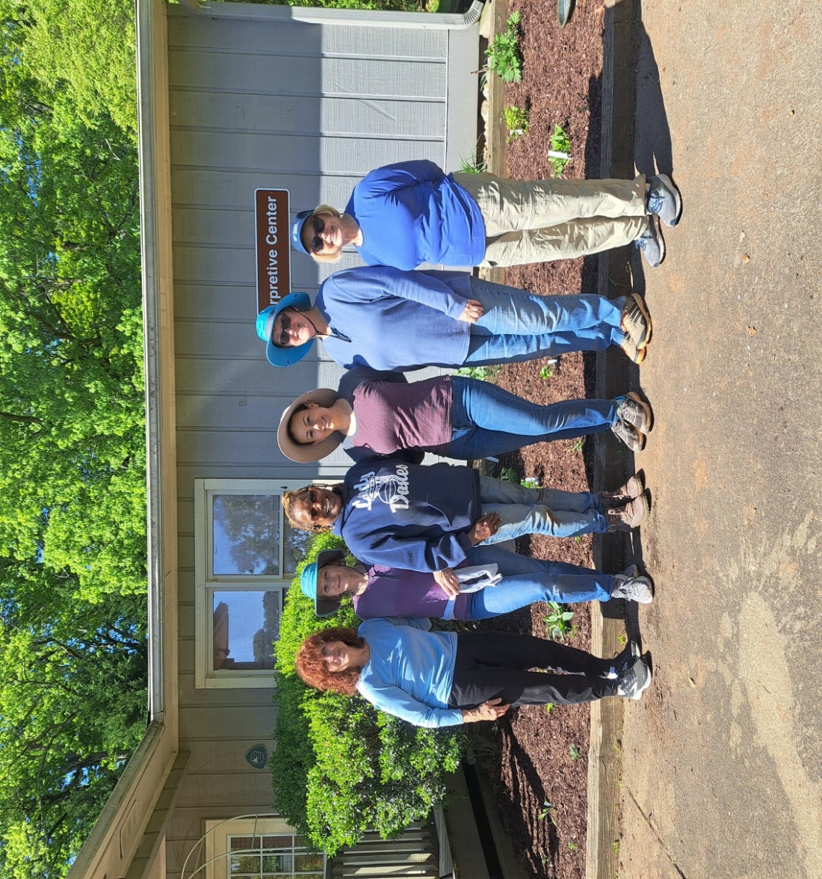
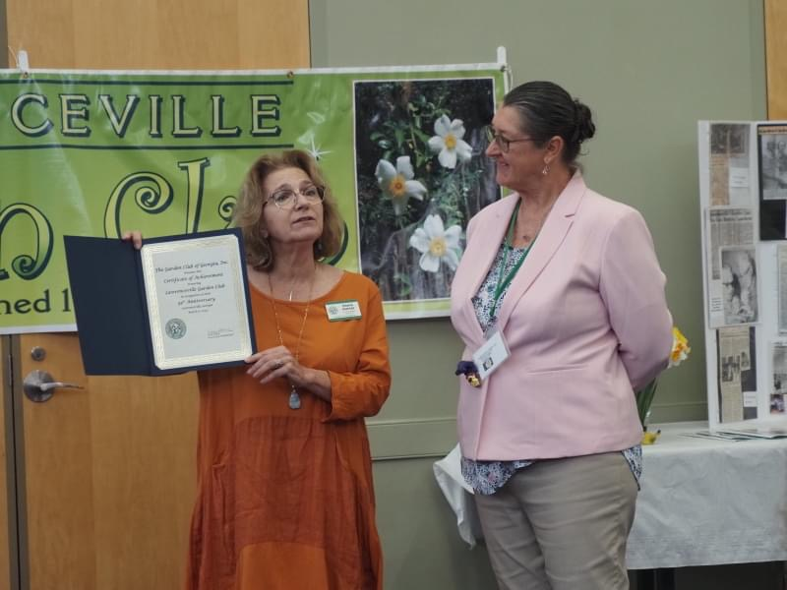
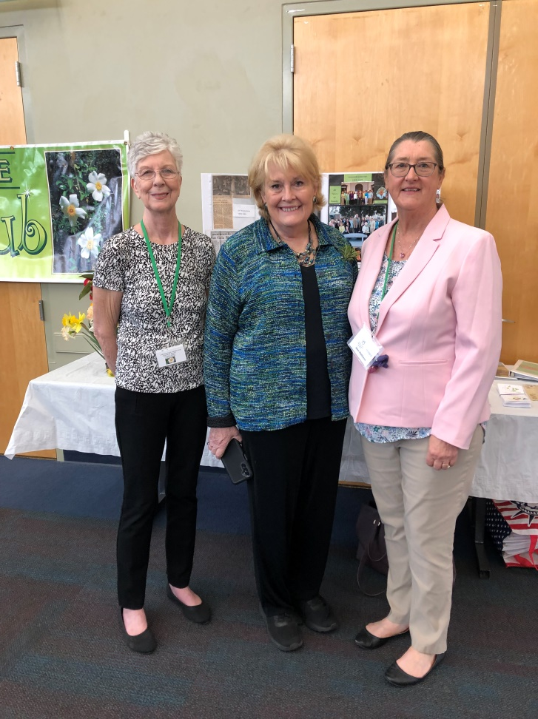
Lawrenceville Garden Club
Lawrenceville Garden Club Celebrates 95th Anniversary with Party, Planting, and Flower Show
To celebrate the 95th anniversary of the Lawrenceville Garden Club, members planted a native garden at Fort Yargo State Park.
March 2024 marked 95 Years of Beauty for our club, not only did we plant the native garden but we had a wonderful party to celebrate. We brought out all the memorabilia and had a non-standard flower show. Guests were Diane Hunter and Barbara Bourque and the Mayor of Lawrenceville David Still. Submitted by Jane Matthews
Celebrating at Fort Yargo: Ann Childers, Robin Moreman, Gwen Washington, Jane Matthews and Rachel Bronnum
Diane Hunter and Jane Matthews review memorabilia.
Sandra Calkins, Barbara
Bourque, and Jane
Matthews

Slide 20
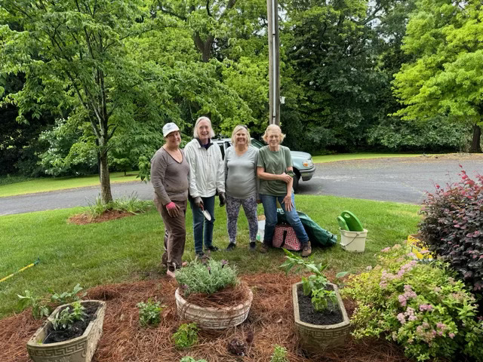
Sope Creek Garden Club
Members of Sope Creek Garden Club, Laurel District, met at the Marietta Educational Garden Center on May 9th to plant an herb garden. Herbs were selected for their historic medicinal qualities. The project was a brainchild of President Deborah Paul.
Pictured in photo are Susie Tabor, Victoria Rixey, Debbie Dreas, and Shirley Walker.
Submitted by:
Victoria Rixey, Co-President, Sope Creek Garden Club

Slide 21
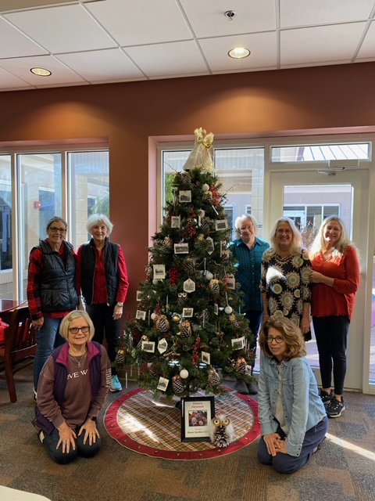
Sixes Community Garden Club
Sixes Community Garden Club Participates in Festival of Trees in Canton
Sixes Community Garden Club members gathers around their themed tree.
The tree must adhere to statement of purpose for set by the community.
The Statement of Purpose for Festival of Trees: Sequoyah Regional Library System, Canton, GA hosts an annual Festival of Trees from mid-November through the 1st of January. Community members are invited to put up their trees which should be decorated in accordance with a theme that they chose but is representative of their organization. The trees are displayed across a multiple of Sequoyah Regional libraries and provide a beautiful backdrop to the holiday events at the library.
Submitted by Susan Wolff, President
Using photos from the 1930’s and 1940’s , Sixes’ decorated their tree with an historical theme.

Slide 22
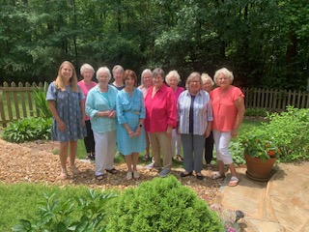
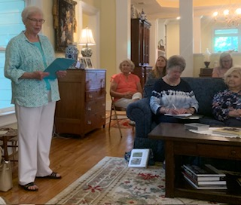
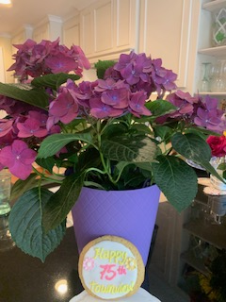
Townview Garden Club
Townview Celebrates 75th Anniversary in May
Front row: Stanley Boulee, Judy Howerton, Pres., Melissa Phillips, Diane Harbin, Trudie Sansbury and Pam Roberts.
Back row: Marilyn Goff, Carol Greissinger, Vickie Hill, Francis Wiggins, and Margaret Lambert.
Townview Garden Club of Rome celebrated their 75th Anniversary in May with a lovely luncheon held at the home of Marilyn Goff. Although no founding members are still living, the foundation they provided is the basis for a very active club today. The projects they continue to support around the city are greatly appreciated by not only the citizens of Rome but also by visitors to the city who often use their gardens as backdrops for pictures.
Their club President, Judy Howerton, announced a number of first place awards presented at the GCG Convention in April. Pam Roberts, a member since the 1970’s, shared the history of the club. Cheryl Briscoe presented a Certificate of Appreciation for 75 Years on behalf of Lisa Hall, GCG President.
This club has a rich history and a bright future! Congratulations on 75 Years’ service to the Rome community.
Judy Howerton,
President

Slide 23
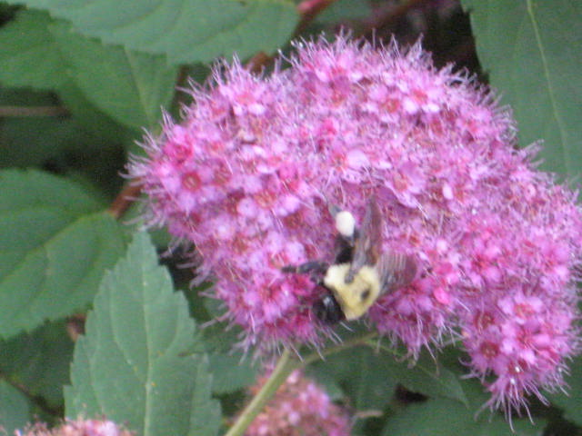
From the Editor
Laurel Letters Newsletter
Fall Issue
Deadline - August 25
Emailed - September 15
Winter Issue
Deadline - November 19
Emailed - December 15
Spring Issue
Deadline - February 25
Emailed - March 15
Summer Issue
Deadline – May 15
Emailed - June
Send information to Laurel Letters Editor:
Shirley Priest
sapriest2@aol.com
Hello, Laurels,
Thank you for you great submissions for the Summer Edition of Laurel Letters. I’ve enjoyed seeing excellent photos of projects and members as well as the well-written articles. Wow…we Laurels have it going on for sure.
Have a great summer and hope all your gardens are full of blooms.
Shirley

